Slide 1


Improved Warnings for Natural Hazards:
A Prototype System for Southern California
Yehuda Bock
Research Geodesist
Scripps Institution of Oceanography
University of California San Diego, La Jolla, CA
Mark Jackson
Meteorologist in Charge
NOAA/National Weather Service, Los Angeles/Oxnard, CA
Angelyn Moore
Research Scientist
NASA Jet Propulsion Laboratory, Pasadena, CA
AGU Press Conference
December 10, 2013
Notes:
Scientists at Scripps Institution of Oceanography at UC San Diego and NASA’s Jet Propulsion Laboratory have enhanced GPS technology to develop new systems that warn of threats from natural hazards such as earthquakes, tsunamis, and extreme weather events. Real-time information from geodetic/GPS stations upgraded with small, inexpensive seismic and meteorological sensors is made available to emergency personnel, decision makers, and first responders. The system was used in July by NOAA National Weather Service forecasters in San Diego and Oxnard to track a monsoon event and issue accurate flood warnings. The technology is now being integrated into other real-world test cases, including monitoring of critical infrastructure such as hospitals and bridges.

Slide 2
Main News Items
Prototype early warning system in southern California that warns of threats from natural hazards such as earthquakes and extreme weather events, and assesses damage to critical infrastructure
System first used in July by NOAA National Weather Service forecasters in San Diego and Oxnard to forecast a summer monsoon event and issue accurate flood warnings
Technology is now being integrated into other real-world test cases, including monitoring of critical infrastructure such as hospitals and bridges
Real-time information from GPS stations upgraded with small, inexpensive seismic and meteorological sensors made available to emergency personnel, decision makers, and first responders to help mitigate threats to public safety.

Slide 3
Goal
Use GPS infrastructure developed over the last decade by many geophysicists and geodesists to:
Save lives during natural events, including earthquakes, tsunamis, extreme storms and flooding, and mitigate and assess damage to infrastructure such as hospitals, tall buildings and bridges

Slide 4
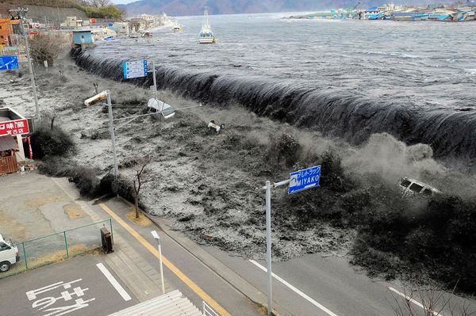

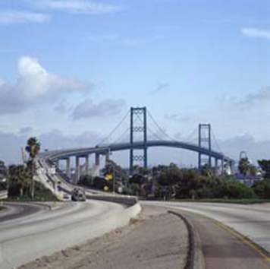
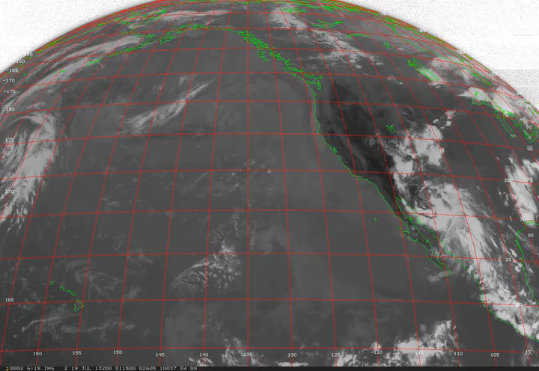
Natural Hazards Risks
Earthquakes/Tsunamis
Structural Collapse
2011 Honshu Japan
Downtown Concepcion, Chile
2010 M8.8 Maule earthquake
(National Geographic)
Extreme Weather
Critical Infrastructure
Vincent Thomas Bridge, Long Beach – in progress for Caltrans (2013)
Summer Monsoon
Notes:
At SIO, we’ve developed the technology for mitigating the effects of natural hazards. Some events we’ve worked on are the devastating 20,11 Honshu earthquake and tsunami in Japan and the Stromboli volcano eruption in 2004 in Italy. Currently, we are applying our technology to monitor the Vincent Thomas Bridge in Los Angeles under contract to Caltrans.

Slide 5
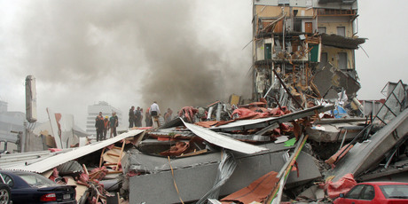
Monitoring Tall Buildings
Collapse of the five-story CTV building in Christchurch, New Zealand during the 2011 Mw 6.1 earthquake resulting in 115 fatalities
Downtown Concepcion, Chile after the 2010 M8.8 Maule earthquake with severely damaged tall buildings leading to loss of life.

Slide 6
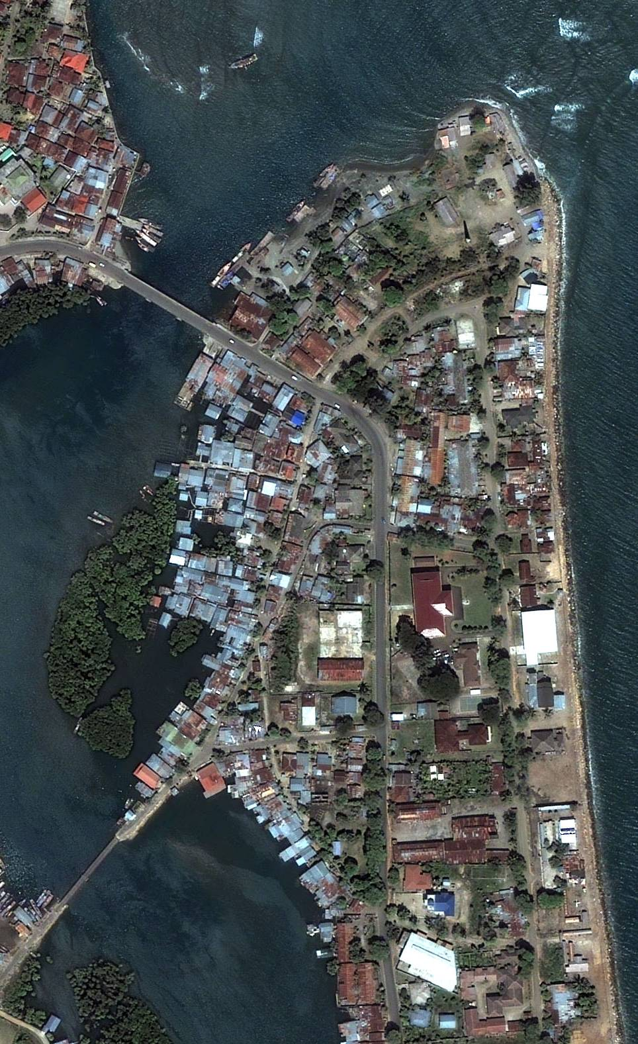
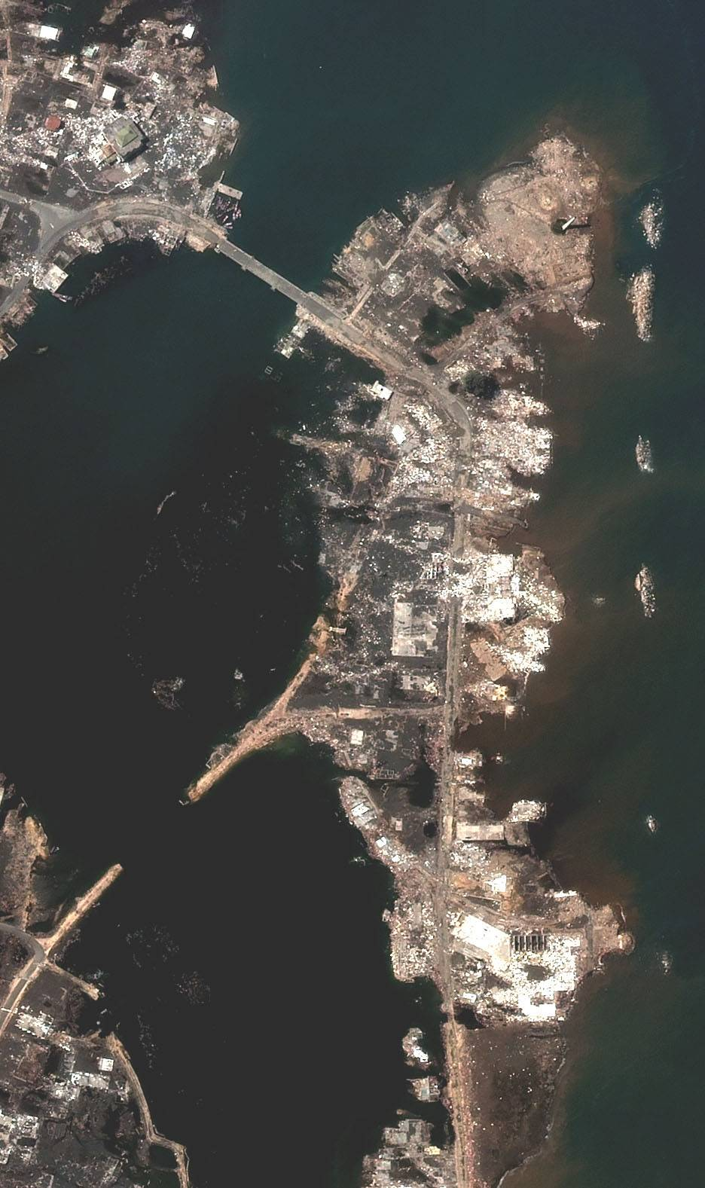
Tsunami Risk
Banda Aceh, Sumatra, Indonesia before 2004 Mw 9.2 Great Sumatra earthquake & tsunami
Banda Aceh after 2004 disaster: 200,000 casualties in Sumatra alone

Slide 7
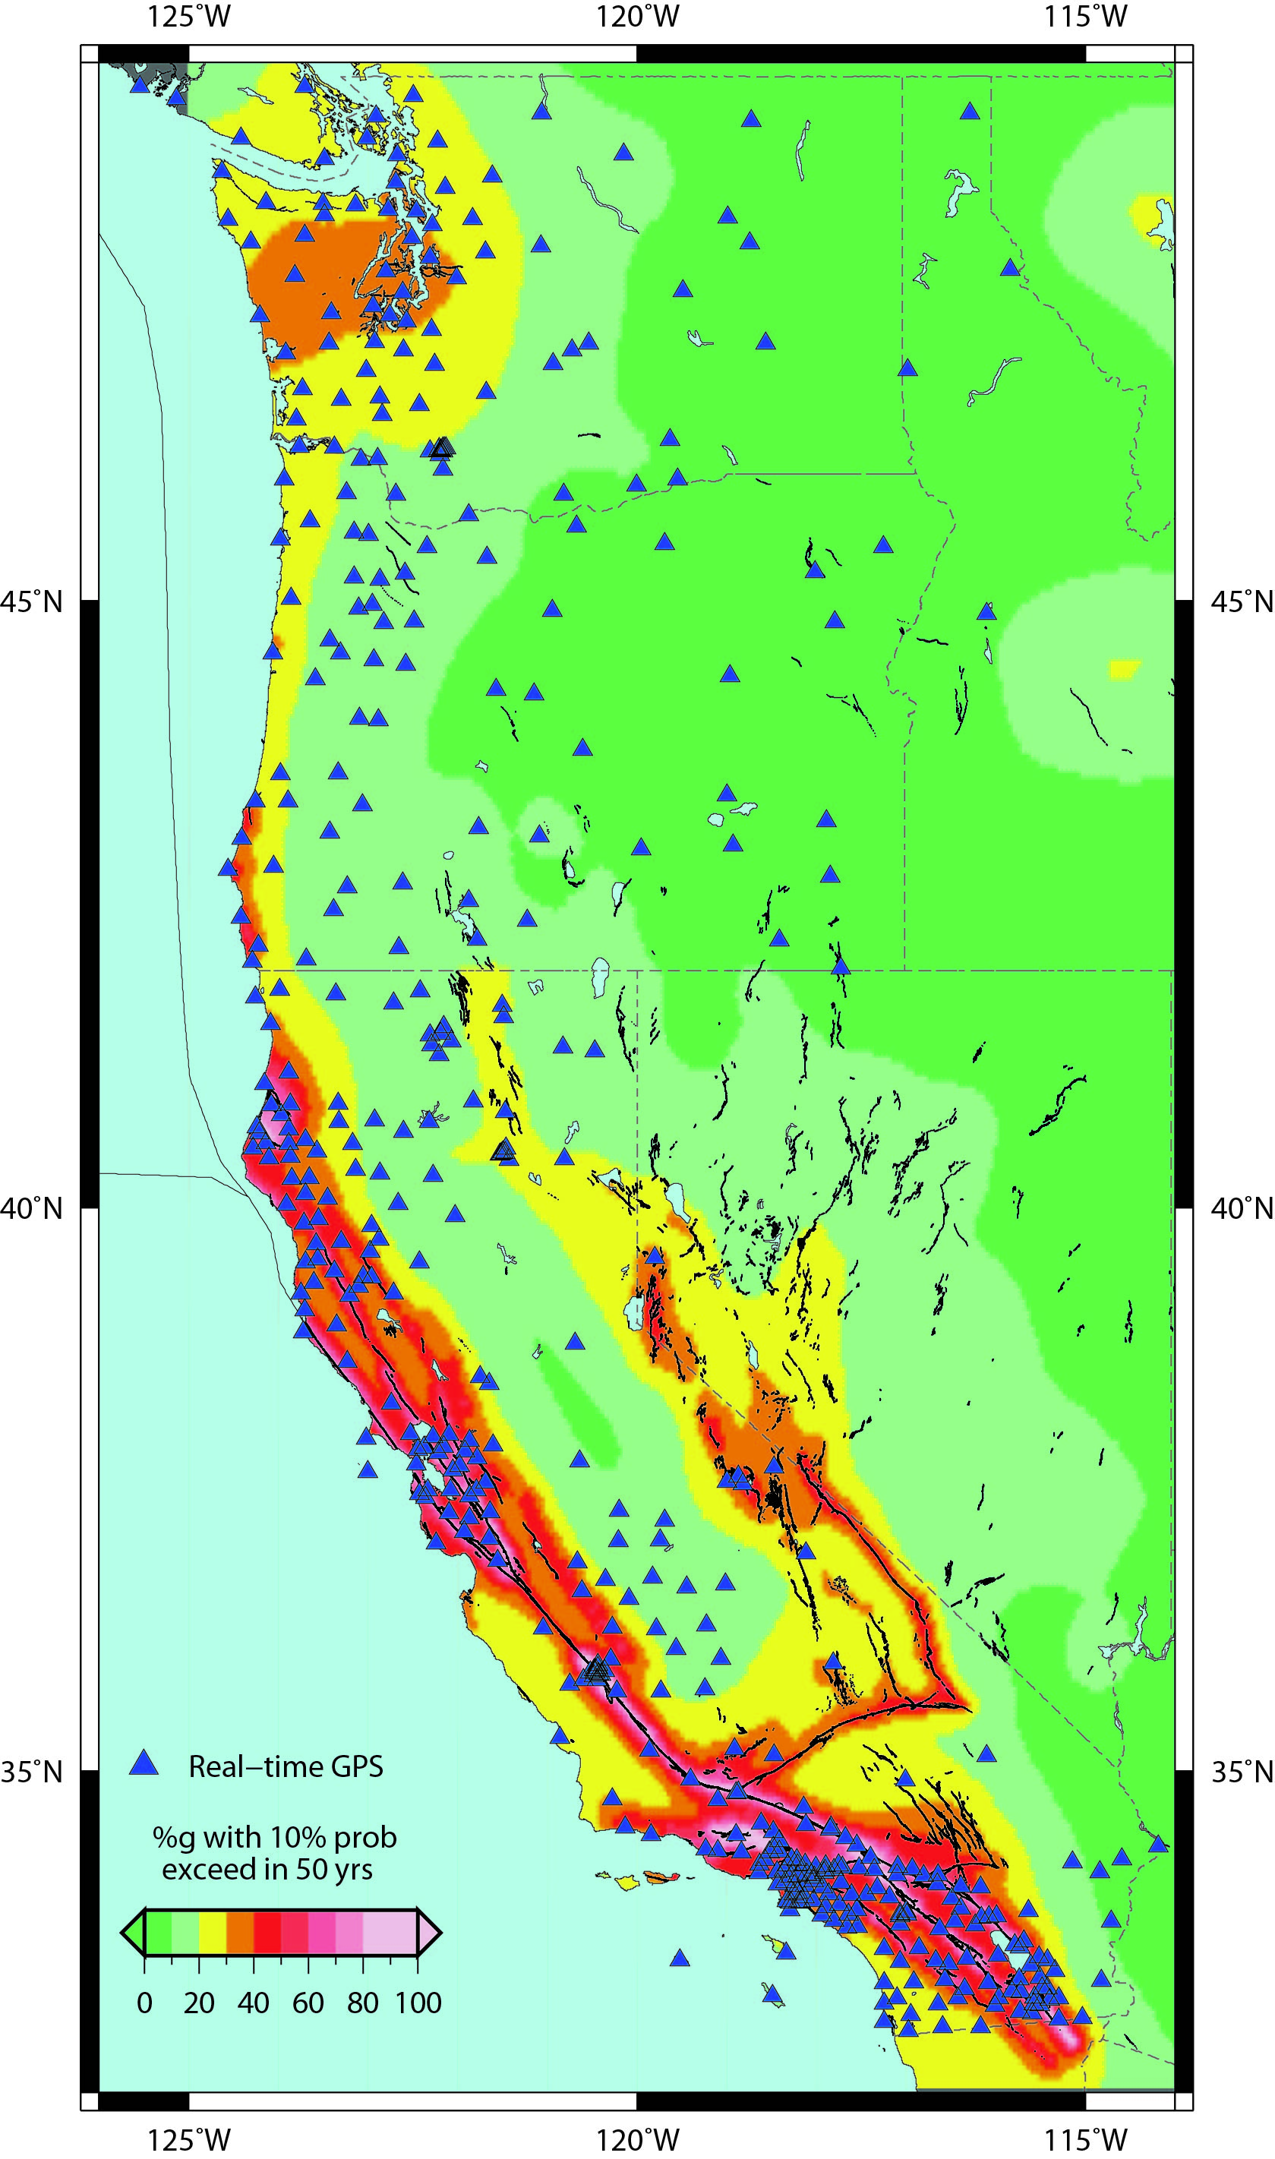
Real-time Precise GPS Network on West Coast
An earthquake & tsunami of the magnitude of Mw 9.0 Tohoku-oki earthquake is possible on Cascadia Subduction Zone
NASA funded Real-Time Earthquake Analysis for Disaster Mitigation Network (READI), ~600 GPS stations continuously tracking the GPS satellite constellation operated by UCSD/SIO, USGS, UC Berkeley, UNAVCO, Central Washington Univ. The data latency is less than a second and the instantaneous location of the station is accurate to a fraction of an inch.
There is increasing risk of a large earthquake on the Hayward fault in the Bay Area
We are overdue for a large earthquake on the southern San Andreas fault

Slide 8
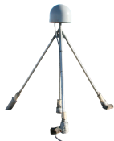
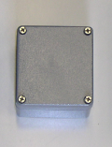

Sensor Integration Provides New Tools for Mitigation Effects of Natural Hazards
Very-high-rate broadband displacements with 1-2 s latency and mm accuracy in three dimensions
+
=
Accelerometer
GPS
Continuous mm-level precipitable water vapor in troposphere
+
=
Met Sensors
(pressure, temperature)
GPS

Slide 9


Our System Provides New Tools for Structural Monitoring
Explanation
Explanation

Slide 10
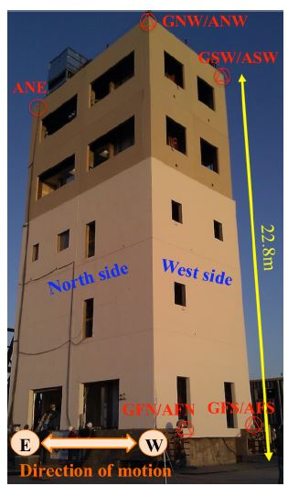
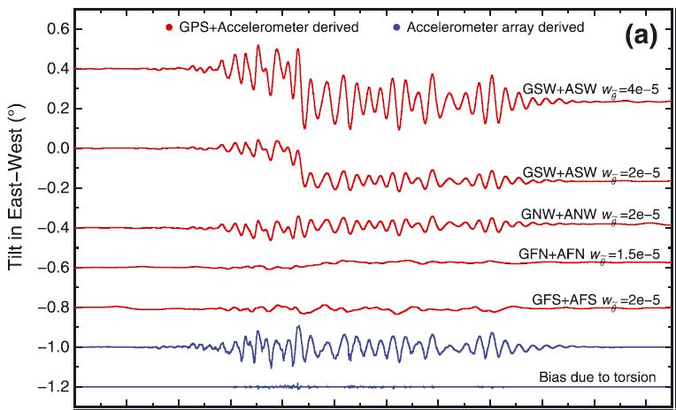
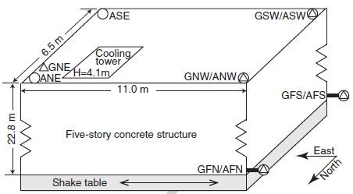
Estimation of Coseismic Tilts
Geng et al., GRL, 2013

Slide 11
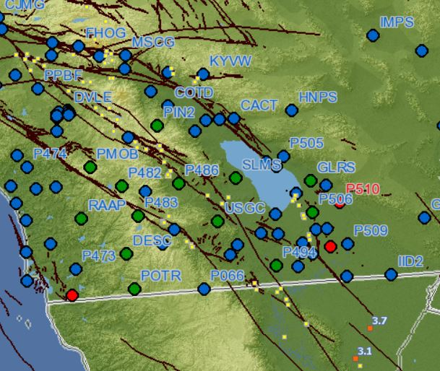
GPS Integration
Green dots are stations upgraded with Geodetic Modules Accelerometer packages

Slide 12
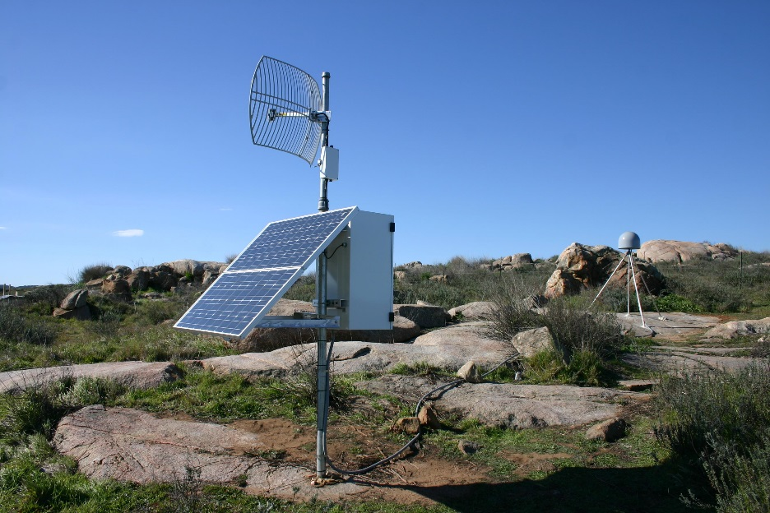
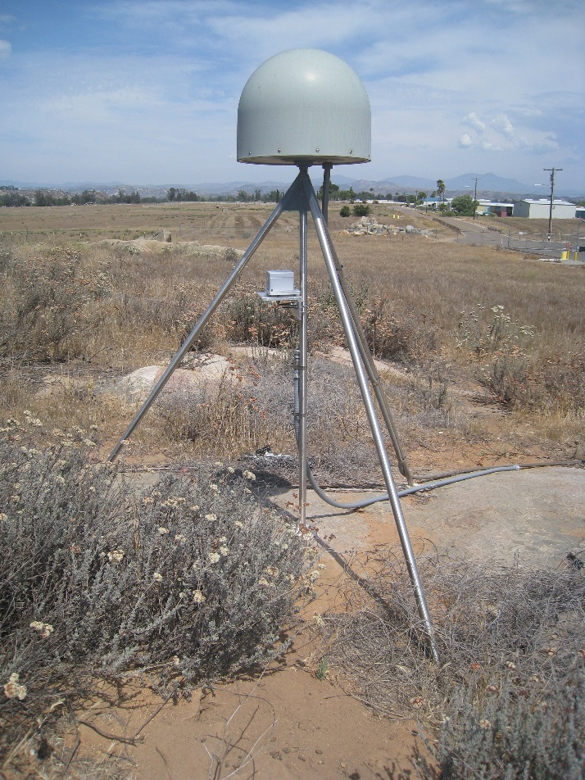
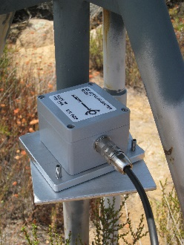
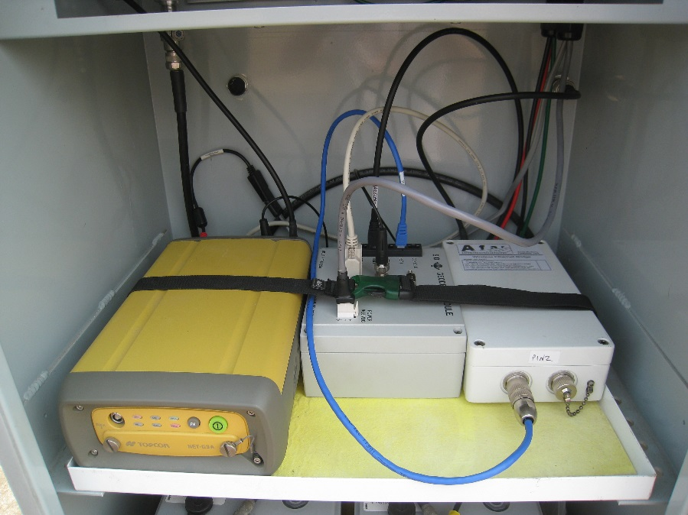
Fusion of GPS and Seismic Data: Seismogeodesy
Upgraded GPS station
Accelerometer deployed on GPS monument
Geodetic Module in equipment box

Slide 13
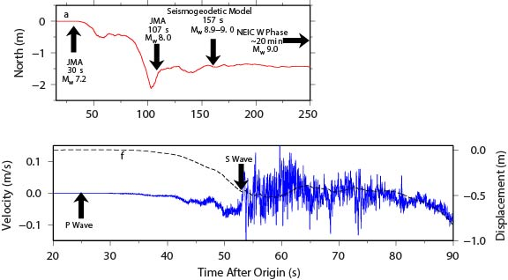
Our System Provides Improvements
on Current Seismic Monitoring
GPS/Seismic is able to better differentiate the magnitude of large earthquakes (Mw 7-9) in real time
GPS/Seismic can also detect the arrival of seismic P waves used in earthquake early warning, but also the permanent motion of the ground
Source:
Melgar et al., GRL, 2013

Slide 14
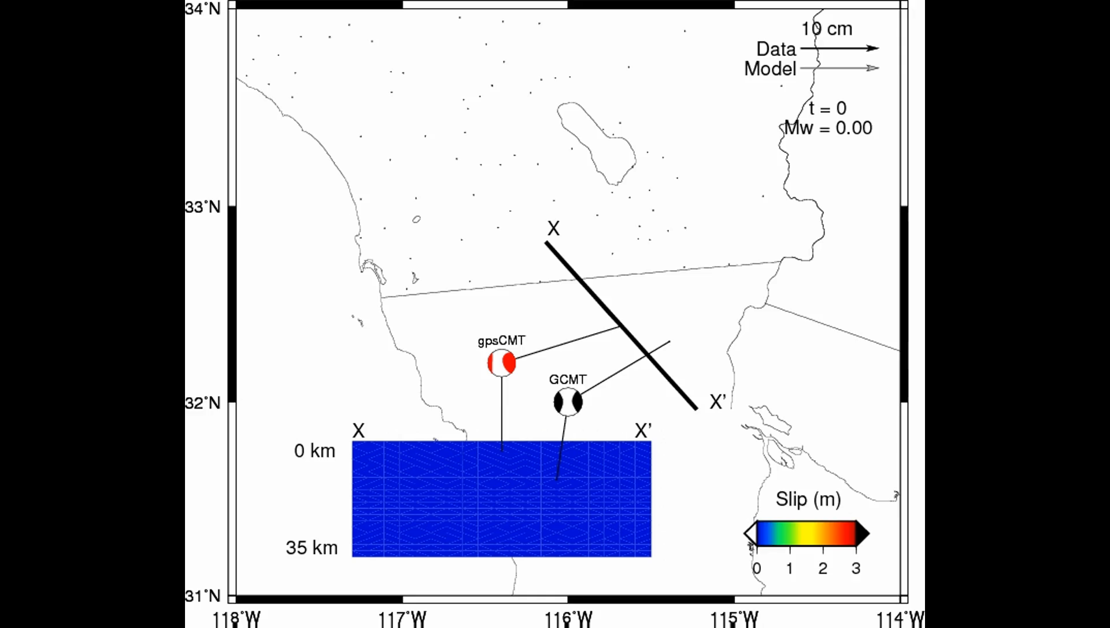
Model for 2010 Mw 7.2 El Mayor-Cucapah earthquake in northern Baja California – Data were collected in real time, and a model was generated within 2 minutes of event with replay of data

Slide 15
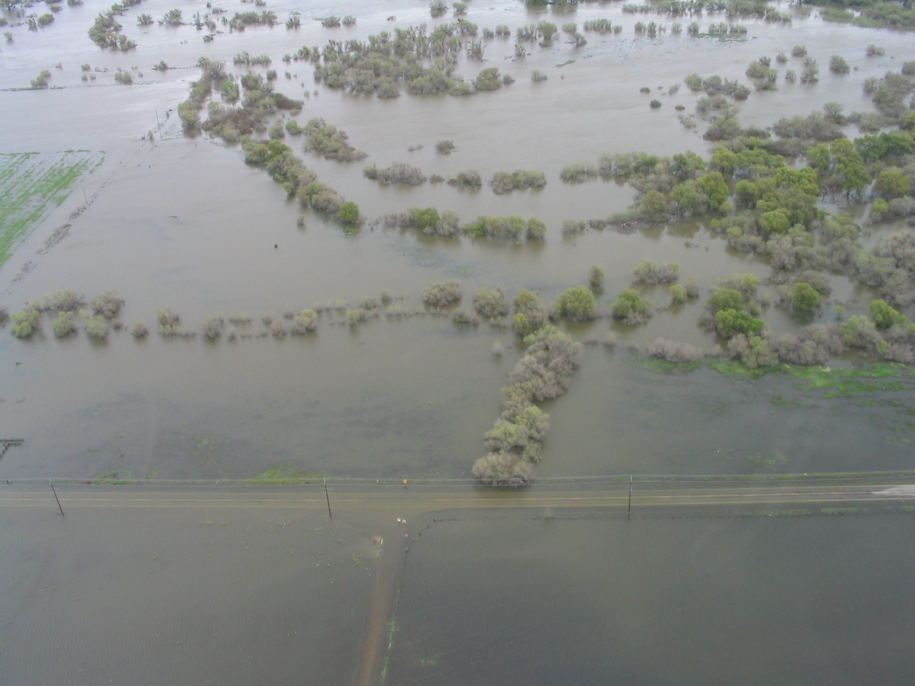
Data, Data, Data
Warning and Forecasting Extreme Precipitation in California
NOAA Photo

Slide 16
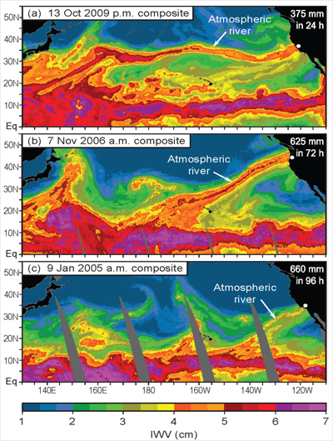
Atmospheric Rivers (AR) are long and narrow streams of atmospheric water vapor that are responsible for many, if not all, winter heavy precipitation events in the Western U.S.
The amount of water in an AR is 7 to 15 times the amount that passes through the mouth of the Mississippi River.

Slide 17
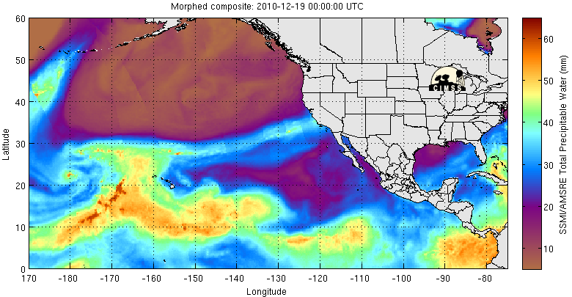
Total Perceptible Water From Satellite
(not available over land)
Loop Starts December 18, 2010
Loop Ends December 22, 2010
Heavy rain in southern Calif.
Atmospheric River
Moisture Source

Slide 18
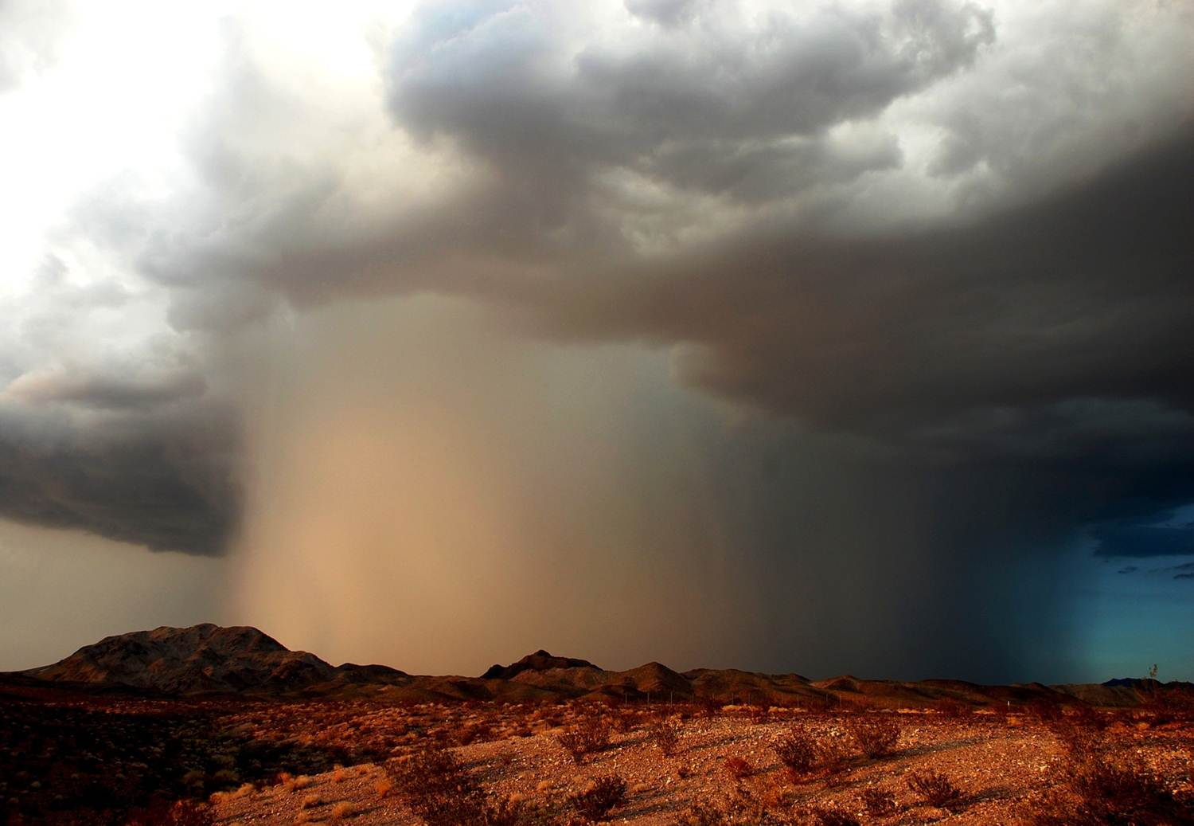
Accurate forecasts and warnings of flash flooding events depends in large part on timely and accurate information of the moisture available for intense thunderstorms
Strong thunderstorm with flash flooding near Ludlow, California (Photo Credit: Will Wilkens)

Slide 19
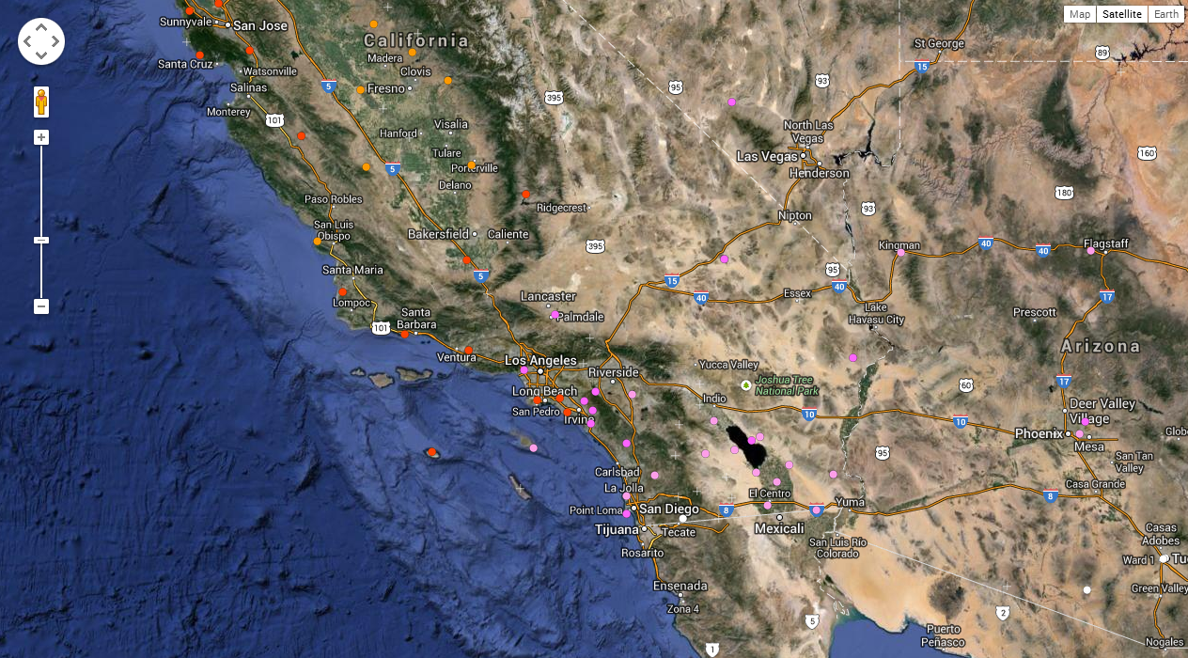
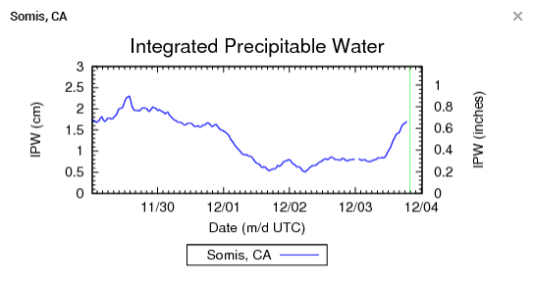

Surface-based Water Vapor Data Sites
= Weather balloon sites (max of 2x per day)
= GPS Integrated Precipitable Water network sites (continuous)

Slide 20
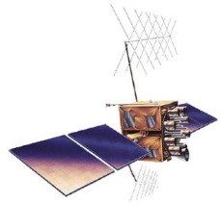

Because signals from the GPS satellites are affected by moist air, when we measure the position of a GPS station, we automatically also measure the atmospheric water vapor above.
Notes:
A GPS station measures the length of time that signals travel from the GPS satellites to the receiving antenna, and through triangulation this determines the position. But the signal travel time is also affected by the amount of water vapor it travels through. This figure is depicting that signals that go through moist air, denoted by a cloud, travel more slowly than signals that go through dry air. Due to this effect, when we measure a GPS station’s precise position, we are automatically also measuring the amount of water vapor in the atmosphere. NASA has invested for many years in JPL and Scripps collaboratively developing technology that measures and utilizes GPS motion and water vapor products, so when this real-time seismology project was shaping up, it was natural for us to include a real-time atmospheric product. The National Weather Service Forecast Offices became our technology infusion partners to exploit this data type for weather forecasting, which Mark will be talking about in detail shortly.

Slide 21
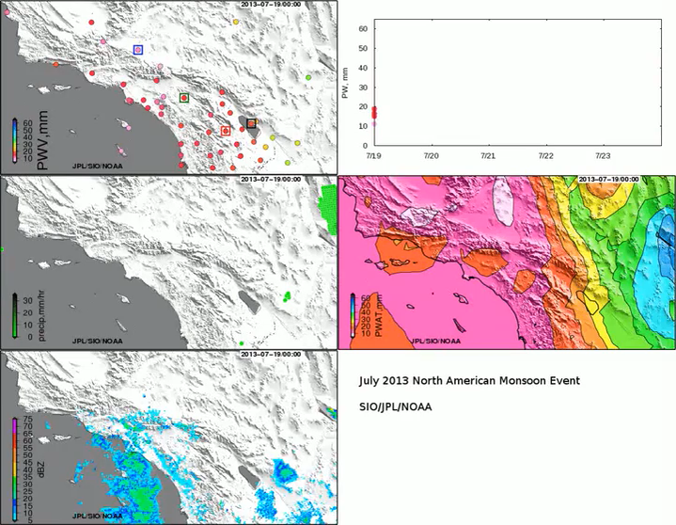
July 2013 North American Monsoon Event
GPS PW
GPS PW (stations boxed at left)
RAP PW
Stage II Blended Precip
Radar (base reflectivity)

Slide 22
Funding and Partners
NASA – GPS/Seismic integration, READI project, structural monitoring
NSF – Upgrade GPS stations with accelerometers
NOAA – GPS/Met Integration (GPS Meteorology)
National Weather Service partnership, San Diego and Los Angeles – monitoring extreme weather events
San Diego Office of Emergency Services – earthquake and tsunami early warning
UC San Diego Medical Center – monitor Hillcrest hospital and provide early warning
Caltrans – monitor Vincent Thomas bridge, Long Beach Harbor
California Spatial Reference Center – operate real-time GPS network for surveying engineers & GIS specialists
Notes:
We’ve been awarded about $1.7M from NASA, NSF, NOAA and Caltrans. One of the NASA projects is specifically intended for commercialization of structural monitoring research – our participation today is part of that effort

Slide 23



Questions?

