Slide 1
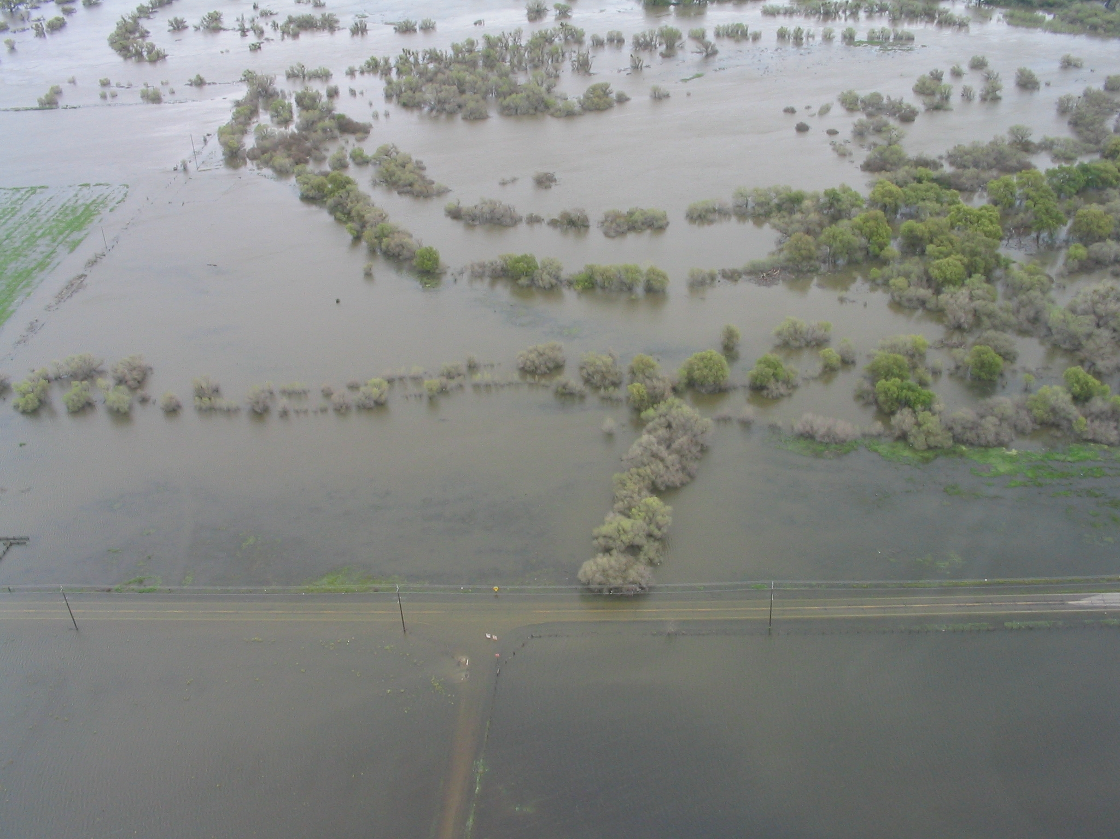
Data, Data, Data
Warning and Forecasting Extreme Precipitation in California
Mark Jackson Meteorologist in Charge NOAA/National Weather Service Los Angeles/Oxnard, CA
NOAA Photo

Slide 2
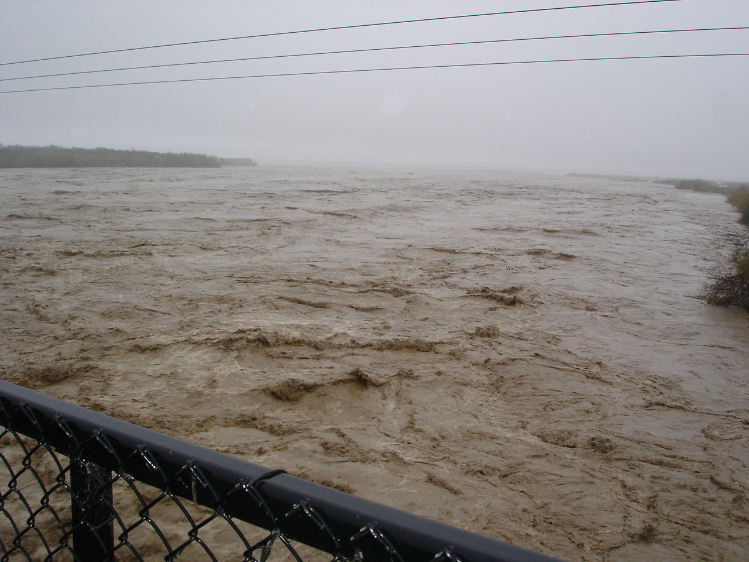
California gets as much rain as the U.S. Gulf Coast gets from hurricanes
Lift plus moisture = Precipitation!
NOAA Photo

Slide 3
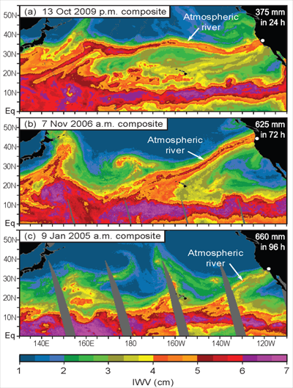
Atmospheric Rivers (AR) are long and narrow streams of atmospheric water vapor that are responsible for many, if not all, winter heavy precipitation events in the Western U.S.
The amount of water in an AR is 7 to 15 times the amount that passes through the mouth of the Mississippi River.

Slide 4
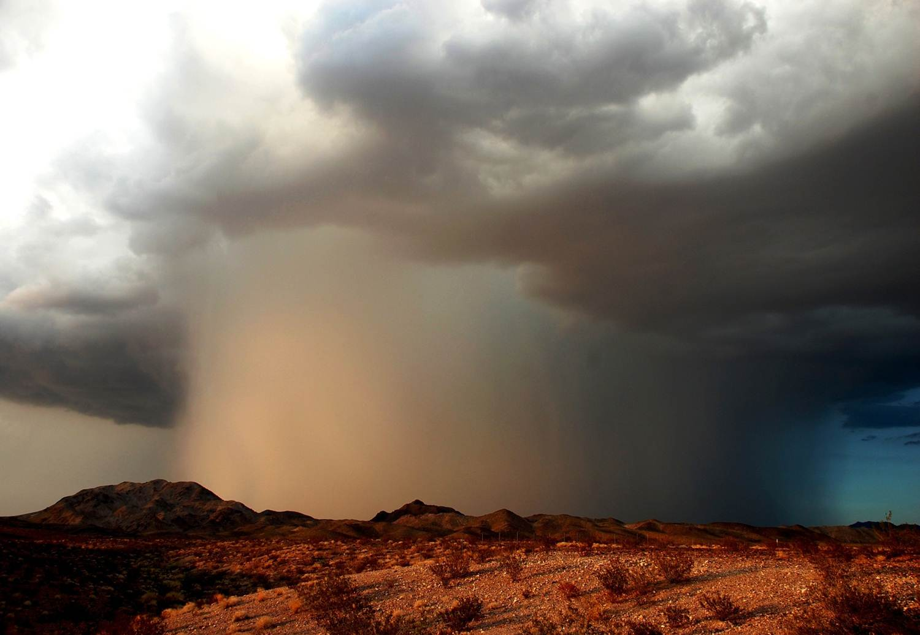
Accurate forecasts and warnings of flash flooding events depends on timely and accurate information of moisture available for intense thunderstorms
Strong thunderstorm with flash flooding near Ludlow, California (Photo Credit: Will Wilkens)

Slide 5
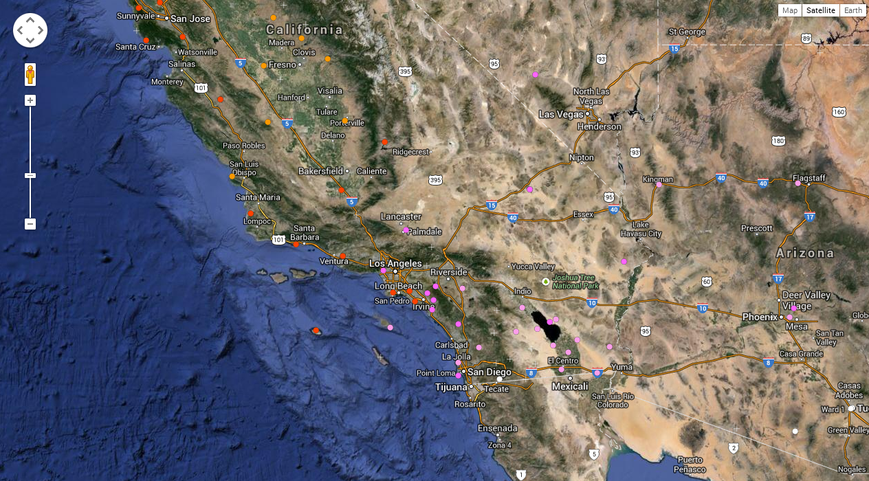
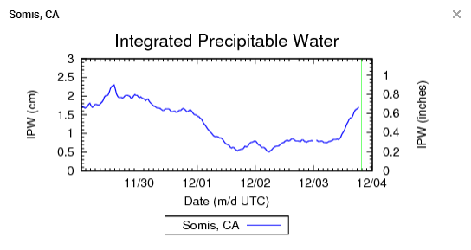
= Radiosonde Balloon sites (max of 2x per day)
= GPS Integrated Precipitable Water sites (1/minute)

Slide 6
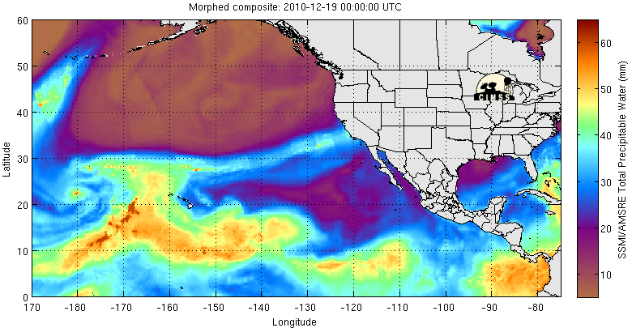
Total Perceptible Water Loop Starts December 18, 2010 Loop Ends December 22, 2010
Moisture Source

